Slide 1
Technical Deep Dive: Creating Apps for the Intelligent Cloud Day 4 – DevOps and ALM
PTC Name:
PTC E-mail:

Slide 2
Success Stories

Slide 3

Eovendo
Cloud-Based Load Testing Produces Cost-Effective Scaling for Ad Rating Service
Large Scale - “VS Online enabled us to focus our time entirely on the implementation, execution and analysis of a complex test suite without the friction of setting up and managing a test lab”
Flexibility – With Visual Studio Online it is fast and easy to adjust the load by provisioning additional resources or set up a completely new load test at any time.
Speed – Visual Studio Online handles the provisioning of test agents and manages the execution of tests. With only a few settings in Visual Studio.
https://customers.microsoft.com/Pages/CustomerStory.aspx?recid=16127

Slide 4

Xerox—ALM
Xerox started out giving its development teams full autonomy, until the scale of the organization and breadth of tools created complexities and lead to difficulty in delivering projects.
Complex ALM ecosystem made up of diverse tools resulting in complex infrastructure management and fragmented ALM processes.
Adopt Visual Studio and develop a single ALM strategy for the organization.
40% gain in developer productivity.
Simplified ALM ecosystem.
“We began to implement ALM in 2011 using Team Foundation Server, which replaced a mix of tools. We achieved developer productivity gains of up to 40 percent, thanks, in part, to the integrated set of capabilities of Team Foundation Server and the tight coupling with Visual Studio Ultimate and Visual Studio Test Professional.”
Oscar Garcia Colon, Near Shore Delivery Center Director, Xerox

Slide 5
Xerox—automated builds
Continuous integration across large environments can create bottlenecks with the build servers, forcing long delays for the integration builds and related tests to complete.
Adopting continuous integration caused unexpected spikes and related delays in the build process. Buying new hardware that would site idol at times was not ideal.
Create a hybrid build environment using Microsoft Azure to provision build machines on demand and build in the cloud through a VPM.
Scale to any build level needed.
Only paying for used build capacity.
Environment kept secure through VPN.
“We no longer have wasteful situations where dedicated build servers are underutilized much of the time followed by delays during critical periods. Azure provides what you need when you need it.”
Miguel Santizo, Software Development Manager at Xerox

Slide 6
Xerox—application deployments
Complex application infrastructures and deployments caused delays in releases and high taxes, leading to difficulty in predicting when a solution would be deployed.
Complex application handoffs between dev and operations.
Release Management for Visual Studio 2013 to automate the handoff between development and operations.
Single deployment process to all environments means constant testing of deployment processes.
“Our change advisory board approves a timeframe to get changes into production. Once we enter that approval into the workflow, Release Manager will perform the deployment in the specified timeframe using the same deployment process we tested in the QA environment.”
Miguel Santizo, Software Development Manager at Xerox

Slide 7
Xerox—insight into production
System Center was providing great insight into the infrastructure / operational aspects of the application, but Xerox wanted to dive deeper into the code performance in production.
Become proactive in identifying issues within the code base before they happen and address them, but without significant time investment.
Application Insights provides fast / simple code instrumentation that is available through the cloud.
Understand if performance issues from code, latency, or bandwidth.
Understand how users interact with the application.
“We also expect better understanding of how our users are interacting with applications because of the powerful telemetry data that Application Insights provides. We can then work with the product owner to retire functions that are not being used, which is not only practical, it saves a lot of effort during updates.”
Oscar Garcia Colon, Near Shore Delivery Center Director, Xerox

Slide 8
Microsoft Services: Azure Practice Jump Starts

Slide 9
Azure Practice Jump Starts
Offers designed to help Partners quickly provide value and become trusted advisors to their customers
Define, structure and manager your Azure IaaS engagements form initial planning and POC to deployment
http://www.microsoftpartnerserverandcloud.com/SitePages/Incentives_DatacenterPracticeGuidanceAccelerator6.aspx

Slide 10
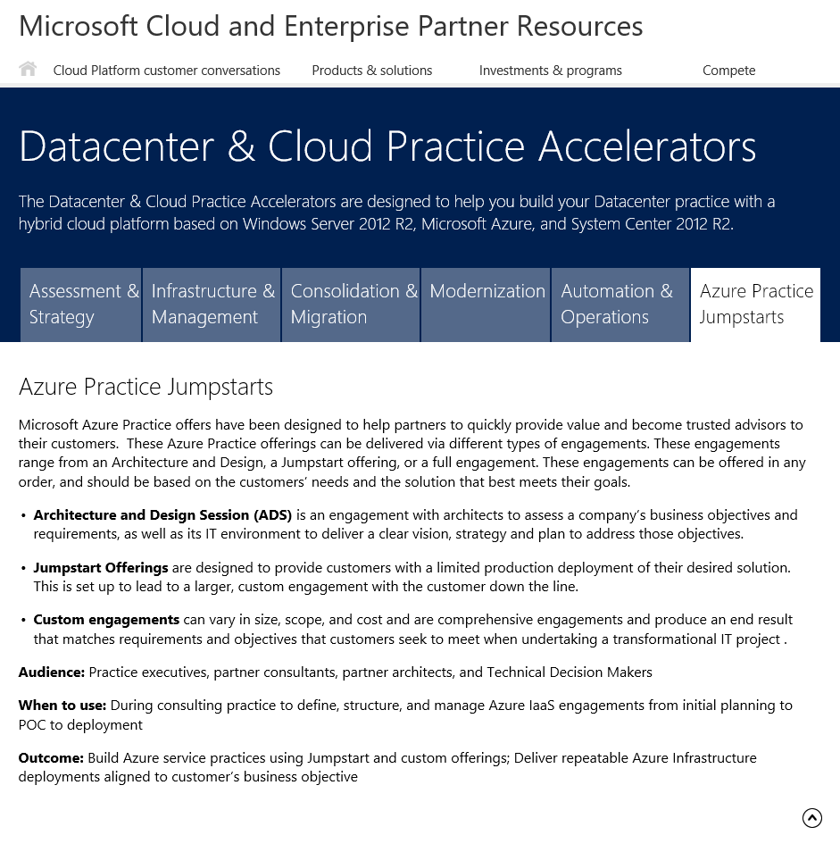
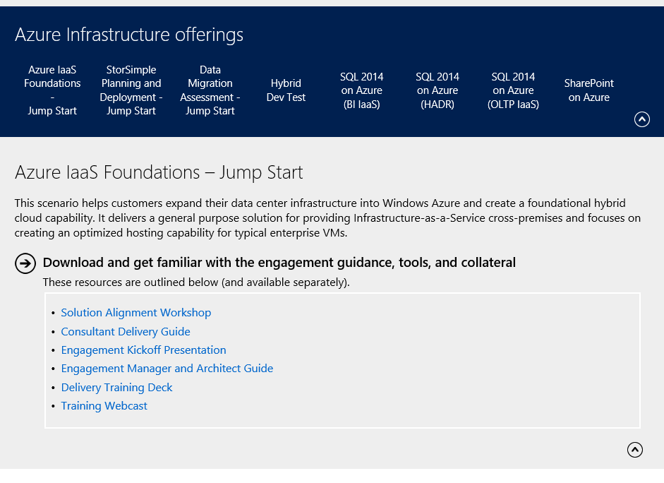
Azure Practice Jump Starts BOM

Slide 11
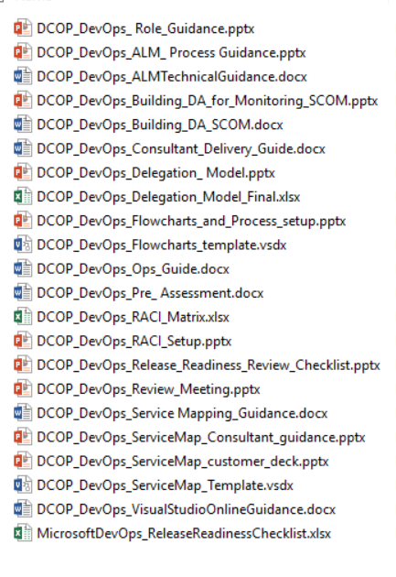
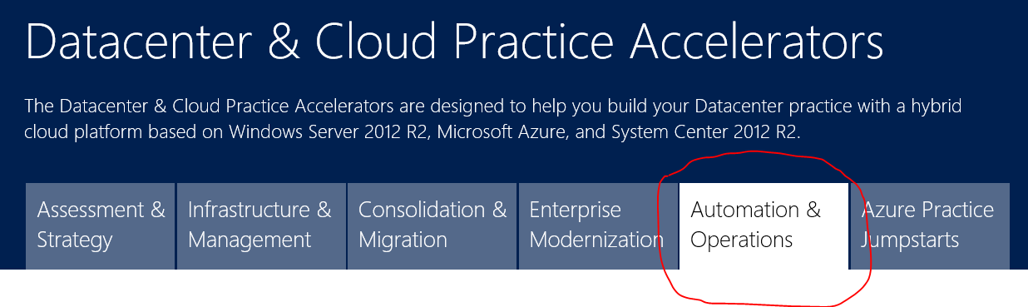
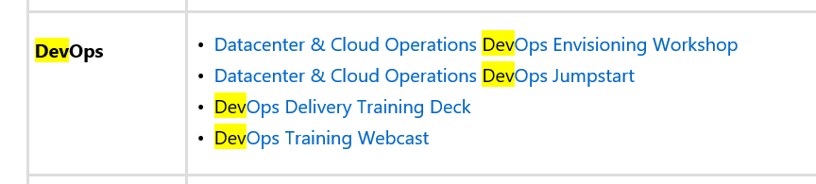
DevOps BOM

Slide 12
Resources

Slide 13
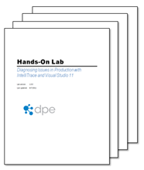
Visual Studio ALM Hands On
The Visual Studio 2013 Update 3 ALM Virtual Machine is available for download along with 25 hands-on-labs / demo scripts which introduce you to many of the ALM capabilities which have been included in this release.
http://aka.ms/ALMVMs

Slide 14
Licensing
Release Management for Visual Studio uses the Management Servers licensing model (similar to System Center). Learn what licenses to purchase and how to enable a continuous delivery release process from Visual Studio Team Foundation Server with Release Management for Visual Studio.
Different pieces of software work together across multiple computers to enable Release Management for Visual Studio 2013.
Required software:
Release Management Client for Visual Studio 2013
Release Management Server for Team Foundation Server 2013
Microsoft Deployment Agent (licensed separately for each target server)
http://www.visualstudio.com/en-us/products/how-to-buy-release-management-vs

Slide 15
Release Management on VSOnline
12 Nov 2014 7:30
As of today, release management is available on VS Online. You just need Visual Studio 2013 Update 4 or later (Premium, Ultimate or Test Professional) for the release management client UI to configure your release pipelines.
The current preview only supports releases targeting Azure environments. In the next few months we’ll add support for releasing to other environments (like on-prem).

Slide 16

DEV Track Resources
http://www.visualstudio.com
http://blogs.msdn.com/b/developer-tools/
http://msdn.microsoft.com/vstudio
visualstudio
@visualstudio
visualstudio

Slide 18
Contact Us Technical services to help you win more deals, accelerate deployment and increase consumption
Microsoft Azure
http://aka.ms/PartnerTechnicalServicesAzure
Microsoft CRM Online
http://aka.ms/PartnerTechnicalServicesCRMOnline
Microsoft Office 365
http://aka.ms/PartnerTechnicalServicesO365
Microsoft Windows 10 and Enterprise Mobility Suite
http://aka.ms/PartnerTechnicalServicesWin10EMS
Learn more about your technical support benefits
http://aka.ms/MySupport

Slide 19
Appendix

Slide 20
DevOps flavors
WebOps
Google, Amazon, Twitter, Facebook, Xbox Live, etc.
NoOps
Small web teams,
start-ups
Enterprise DevOps
Cross-functional organizations

Slide 21
The three ways
DEV
OPS
(Business)
(Customer)
THE FIRST WAY
Flow/systems thinking
THE SECOND WAY
Feedback/amplify feedback loops
THE THIRD WAY
Continual experimentation and learning

Slide 22



DevOps benefits
Efficiency
Lower cost
Higher quality
Continuous learning
Increased flow of value

Slide 23

Microsoft’s ALM framework
Plan
Operate + learn
Requirements
Development
Collaboration
Production
Develop + test
Release

Slide 24
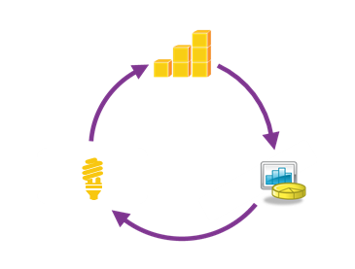
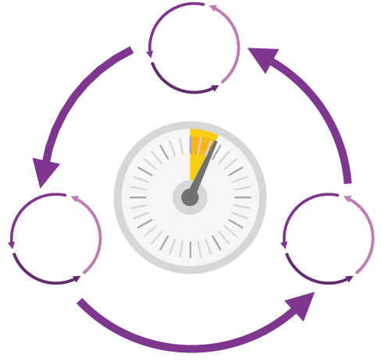
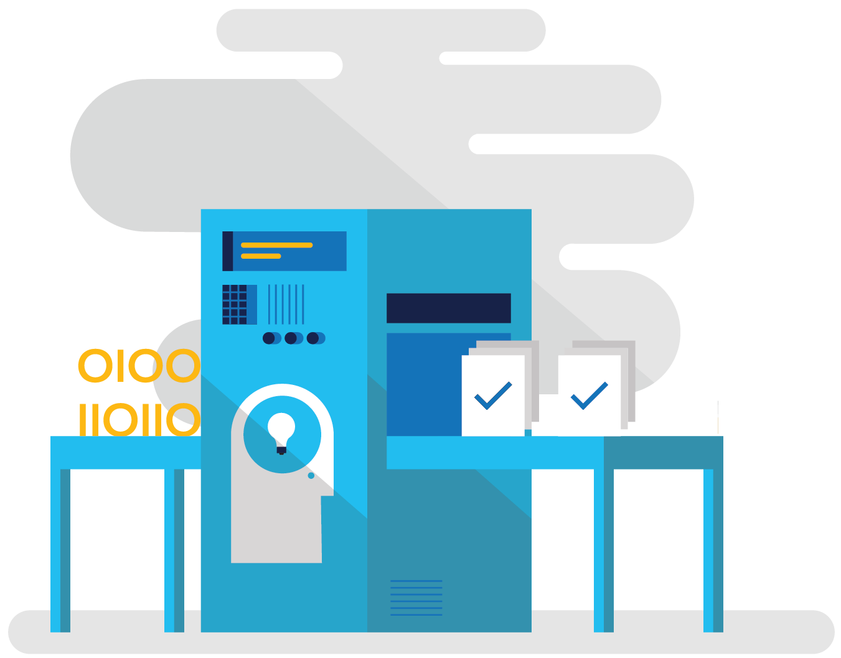
How Microsoft can help increase the flow of value
Shorten cycle times
Optimize resources
Improve quality and availability
Hypothesis-driven development & continuous learning

Slide 25





The Microsoft integrated solution for cloud dev/test
System Center : “Single pane of glass” management experience
Visual Studio cloud services
Azure
production cloud
On-premises
Azure dev and test cloud
App Lifecycle Services
(VS Online and on premises)
Project Management Tools
Version & Source Control
Build & Continuous Integration
Testing
Services
Cloud
Continuous Delivery
Release & Deployment Management
Production
Diagnostics
Lab Management Automation
Monitoring & Analytics
The Azure PaaS Cloud
Mobile services
Web sites
Storage and caching
Data/Big Data
Modern
app dev
services
Development and Test Tools
Media services
Internet service bus
Identity federation
The Azure IaaS Cloud
Dev and Test
Lab
environments
Infrastructure and Apps
Production servers

Slide 26

Visual Studio TFS – Lab Manager
Automate your lab environment to optimize your Application Lifecycle Management.
With Visual Studio’s Lab Management capabilities, you will automate the process of building, deploying, and running automated tests on your lab environment. Stop losing time each day to mundane tasks, and let Lab Management take care of them for you. Your team will get back valuable time that they can spend producing value for your customers.

Slide 27

Futures
Dashboarding
Support for project K/ASP.NET 5
Application Insights
4
Release Management Service GA
Additional DCs for Cloud Load Testing
Agile at Scale
PowerBI support for Visual Studio Online
Open ALM GA
1
3
Extensions
Dev/Test Lab Management in the Cloud
Cloud Load Testing in Azure Portal
Extensibility General Availability
Work Item Customization
Build vNext General Availability
2
Collaborate on Code
Code Policies
Continuous Delivery
Team Explorer Everywhere RTM
Distributed Test Execution and Automation
NuGet Feed Service

